Slide 1


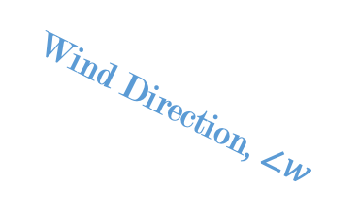






$$y$$
Wind Direction, $∠w$
$$w^{c}$$
$$w^{s}$$
$$x$$
Nacelle Direction, $γ$
$$γ^{c}$$
$$γ^{s}$$

Slide 2
Green – removing data
Purple – filling data
Blue – changing data
Orange – rearranging in time
Power-Wind Speed Window Filter
Raw Data
Resample
Forward Fill
Unresponsive Sensor Filter
Power-Wind Speed Window Filter
Std. Dev. Filter
Feature Transform
Nacelle/Wind Direction Calibration
Power Curve Filter
Split
Impute
Filtered, Continuous Data
Normalization
Removing Data
Filling Data
Training
V
Ts
Rearranging in Time
Changing Data

Slide 3
Green – removing data
Purple – filling data
Blue – changing data
Orange – rearranging in time
Power-Wind Speed Window Filter
Raw Data
Filtered, Continuous Data
Removing Data
Filling Data
Rearranging in Time
Changing Data

Slide 4












$${\hat{X}}_{\text{p}}$$
$$(B, τ_{p}, d_{y})$$
Output Layer
Stacked Decoder
$$(B, τ_{p}, d_{m})$$
Addition & Normalization
Stacked Encoder
$$(B, τ_{c}, d_{m})$$
FFN
Addition & Normalization
Addition & Normalization
TODO check that this holds for informer, autoformer, spacetimeformer
Multi-Head Cross-Attention
FFN
K V
Q
Addition & Normalization
Addition & Normalization
Masked Multi-Head Self-Attention
Multi-Head Self-Attention
K V Q
K V Q
$$(B, τ_{c}, d_{m})$$
$$(B, τ_{p}, d_{m})$$
$$X_{\text{enc}}$$
$$X_{\text{d}\text{ec}}$$
Embedding
Embedding
$$(B, τ_{c}, d_{x})$$
$$(B, τ_{p}, d_{x})$$
$$X_{\text{c}}$$
$$X_{\text{p}}$$

Slide 5










$${\hat{X}}_{\text{p}}$$
$$(B, τ_{p}, d_{y})$$
Output Layer
Stacked Encoder
Stacked Decoder
TODO check that this holds for informer, autoformer, spacetimeformer
Encoder
Layer
Decoder
Layer
$$(B, τ_{c}, d_{m})$$
$$(B, τ_{p}, d_{m})$$
$$X_{\text{enc}}$$
$$X_{\text{d}\text{ec}}$$
Embedding
Embedding
$$(B, τ_{c}, d_{x})$$
$$(B, τ_{p}, d_{x})$$
$$X_{\text{c}}$$
$$X_{\text{p}}$$

